Slide 1
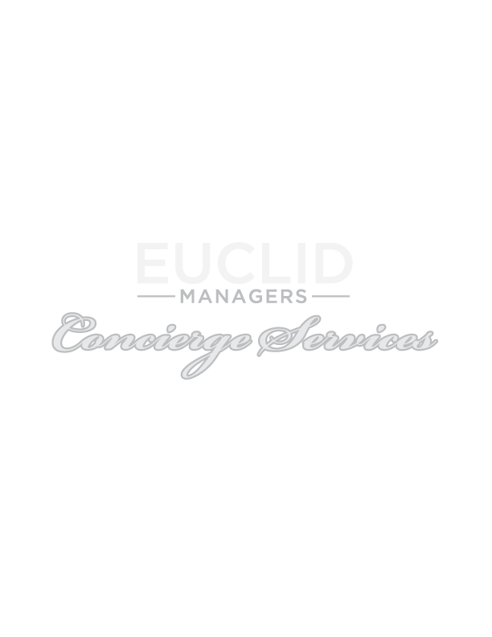
Commissionable non-insurance products

Slide 2
HealthiestYou (a Teladoc division)
Healthiest You is a comprehensive virtual care solution
Employer contribution is required
A division of Teladoc but with a focus on re-directing claims and high utilization
Utilization reports provided to employers
Client Success Managers to assist education
User-friendly app & intelligent savings alerts
Price Transparency Tools
Healthiest You Core - $0 General Medicine + copays for add’l services
HealthiestYou Complete - $0 General Medicine, $0 copay for add’l services

Slide 3
HealthiestYou services:
General Medicine
Mental Health (HY Complete bundle also includes myStrength)
Dermatology
Neck & Back Care (on HY Complete bundle)
Expert Medical Services (on HY Complete bundle)
Nutrition

Slide 4
HealthiestYou benefits as stand-alone offer:
For employers
For employees
Business model promotes high utilization (avg 30-40% 1st year)
Redirect claims from medical plan
All employee coverage, even those not on major medical
High impact on increasing productivity & lowering absenteeism
Offset medical costs
Engagement strategy promotes smooth member experience
Provides high quality access to care with no visit fees
Covers employee & their spouses and dependents at no additional cost
Stays consistent, regardless if there is a change to major medical carrier

Slide 5
HealthiestYou strategies for 4th quarter:
Add to Self-funded groups or employers with high deductibles to re-direct claims
Consider offering to a client’s under-served demographics (part time & 1099’s) – great tool for attracting and retaining employees without the high cost of major medical
Classes excluded from major medical offering (restaurants, realtors, trucking, union)
Employees or dependents not participating on employer plan due to prohibitive cost
15% commission

Slide 6
NortonLifeLock Benefit Solutions
All-in-one protection against threats to employees’ identity, deices & privacy
Most recognized brand in U.S. for Identity Theft Protection
Proactive protection (versus reactive) w/ white-glove restoration service
Voluntary or Employer-Paid options

Slide 7
NortonLifeLock strategies for 4th quarter:
Discuss as part of coverage review: protecting identities of employees just as important to their well-being as protecting their health, teeth, eyes, income
Employers receive tax-deductible benefit when contributing towards identity theft protection for their employees
More than 30% of new groups are Employer paid for the employee coverage (buy up option for dependents) providing a great attraction and retention benefit for employees
Voluntary starts at $8.99 for Employee only, Employer paid is $4.49
20% commission

Slide 8
MetLife Legal Plans
Access to expert guidance & tools to handle a broad range of personal legal needs
Network of prequalified attorneys
Unlimited access for all legal matters covered under the plan
Voluntary ($21.75 monthly ) or employer paid ($13.50 PEPM)
Saves on legal costs for: real estate, civil lawsuits, elder-care issues, driving, financial matters
10% commission (minus fees)

Slide 9
Euclid Managers Concierge Division Conclusion
Information needed for proposal requests:
Market suggestions & ideas to promote:
Employer Name
Requested Effective Date
# of Eligible Employees
Contact your marketing representative for questions and resources
Incorporate as standard option when reviewing prospective or renewal packages
Host informative webinar (no cost)
Auto quote for renewals & new prospects
Consider offering at your own agency

